Slide 1

Project Title – Seasonal Agriculture Performance Analysis
Student name: Subarna Gupta
College name: Miranda House,
University Of Delhi
AICTE STU ID:
STU6a66ec615856b1785130081

Slide 2

PROBLEM STATEMENT
Agricultural performance varies significantly across seasons due to changes in rainfall, temperature, soil conditions, irrigation practices, and resource availability.
Understanding these seasonal variations is important for improving productivity, profitability, and resource utilization.
The objective of this project is to analyze seasonal agricultural data and identify meaningful patterns, trends, relationships, and differences in agricultural performance.

Slide 3
Project Description This project focuses on analyzing agricultural activities across different seasons using Data Analytics techniques. The dataset contains information related to crops, environmental conditions, irrigation methods, production, costs, revenue, and profitability. The analysis was performed using Python and various data visualization techniques to identify seasonal patterns and generate meaningful insights.

Slide 4

WHO ARE THE END USERS?
Farmers
Agricultural Researchers
Agricultural Planners
Government Agencies
Policy Makers
Agricultural Extension Officers
Students and Researchers interested in Agricultural Analytics

Slide 5

Technology Used
Programming Language:
Python
Libraries:
Pandas
NumPy
Matplotlib
Seaborn
Platform:
Google Colab
Version Control:
GitHub

Slide 6
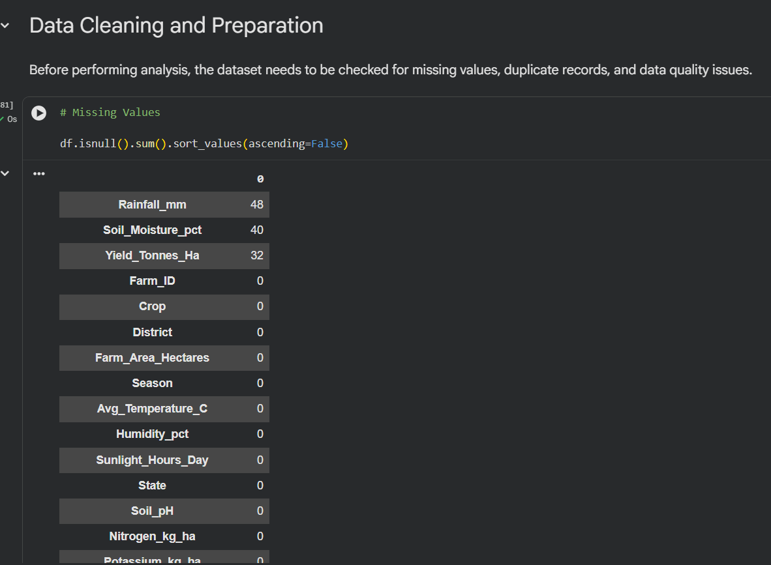
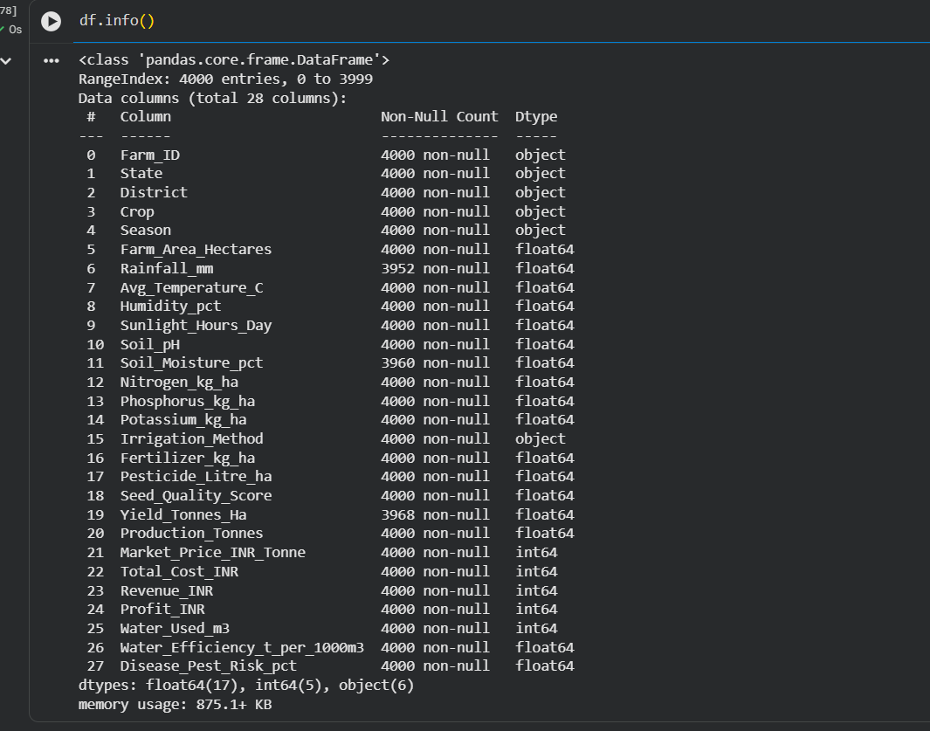
RESULTS
Insight-
The dataset contained 4,000 records and 28 variables covering seasonal, environmental, production, and economic aspects of agriculture. Missing values were identified in Rainfall, Soil Moisture, and Yield columns and were handled appropriately before analysis.

Slide 7
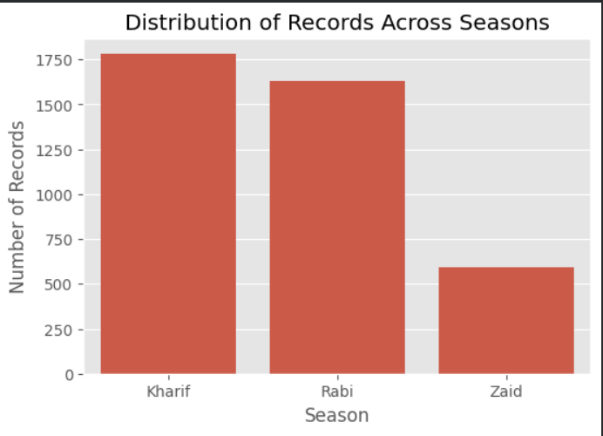
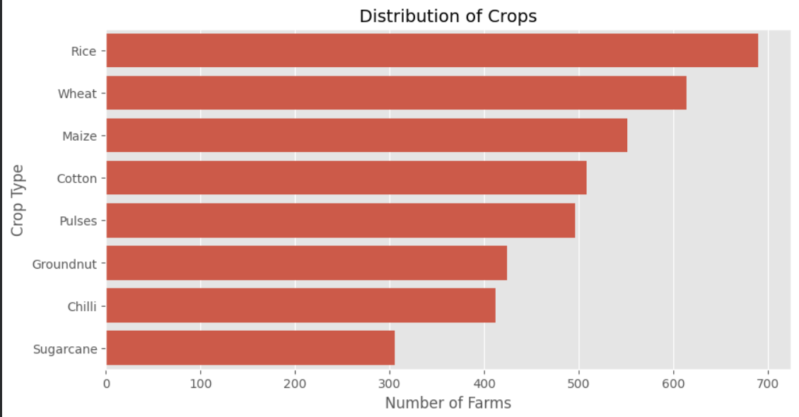
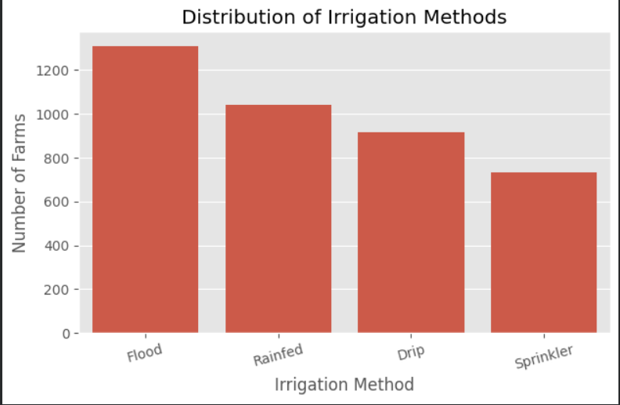
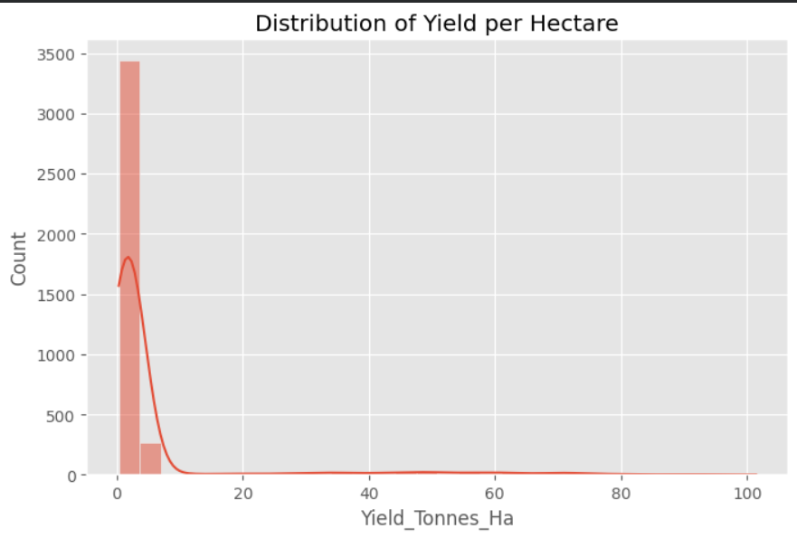
RESULTS
Insight-
The dataset includes three agricultural seasons (Kharif, Rabi, and Zaid), multiple crop types, and four irrigation methods. Kharif had the highest number of records, while Rice was the most frequently cultivated crop. Flood irrigation was the most commonly used irrigation method.

Slide 8
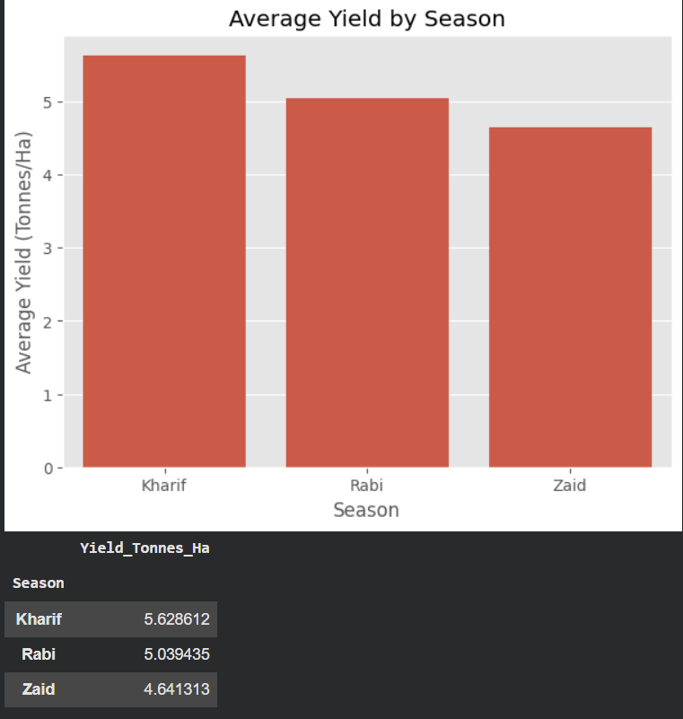
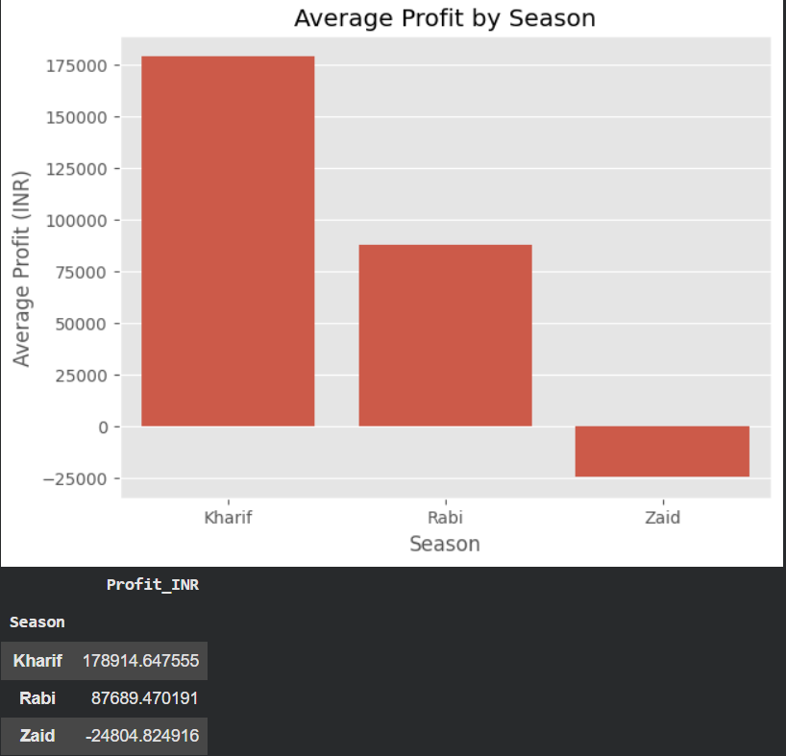
RESULTS
Insight-
Agricultural performance varied significantly across seasons. Kharif recorded the highest average yield and profit, indicating favourable growing conditions. Rabi showed moderate performance, while Zaid recorded negative average profit, suggesting lower economic viability.

Slide 9
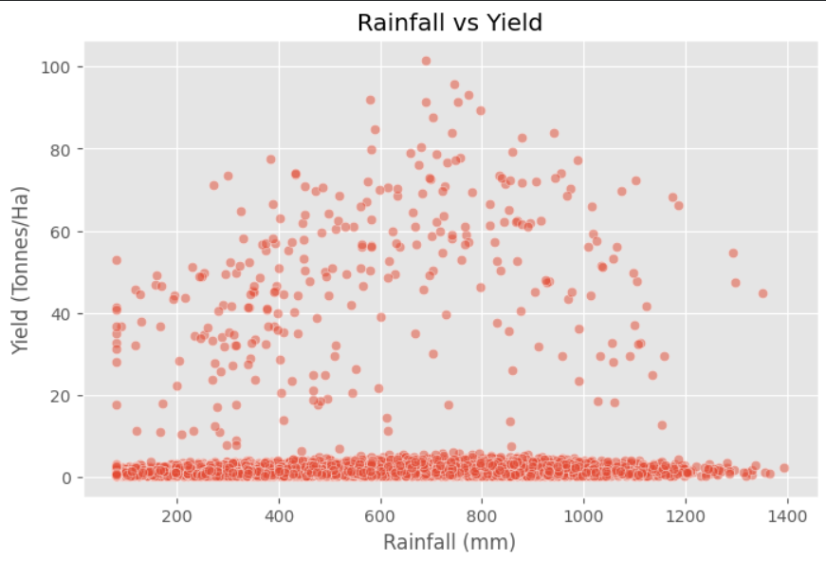
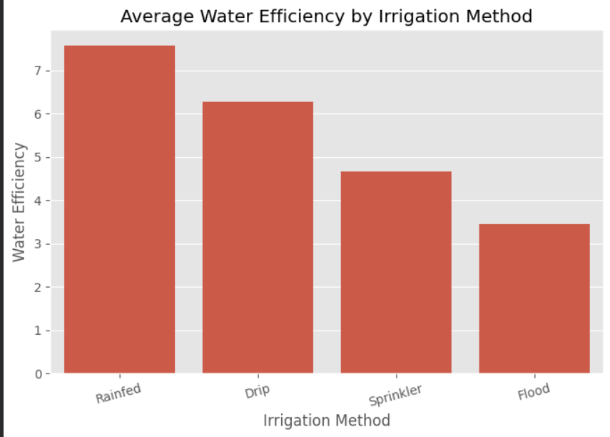
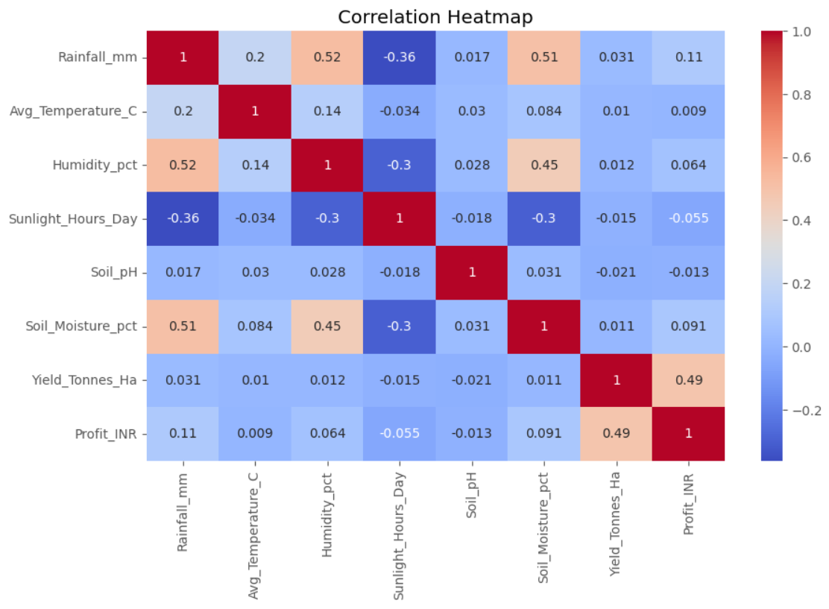
RESULTS
Insight-
Water-related factors played an important role in agricultural outcomes. Rainfall and soil moisture showed positive relationships with productivity. Rainfed and Drip irrigation methods demonstrated better water efficiency compared to Flood irrigation. The correlation analysis indicated that agricultural performance depends on multiple interacting factors.

Slide 10
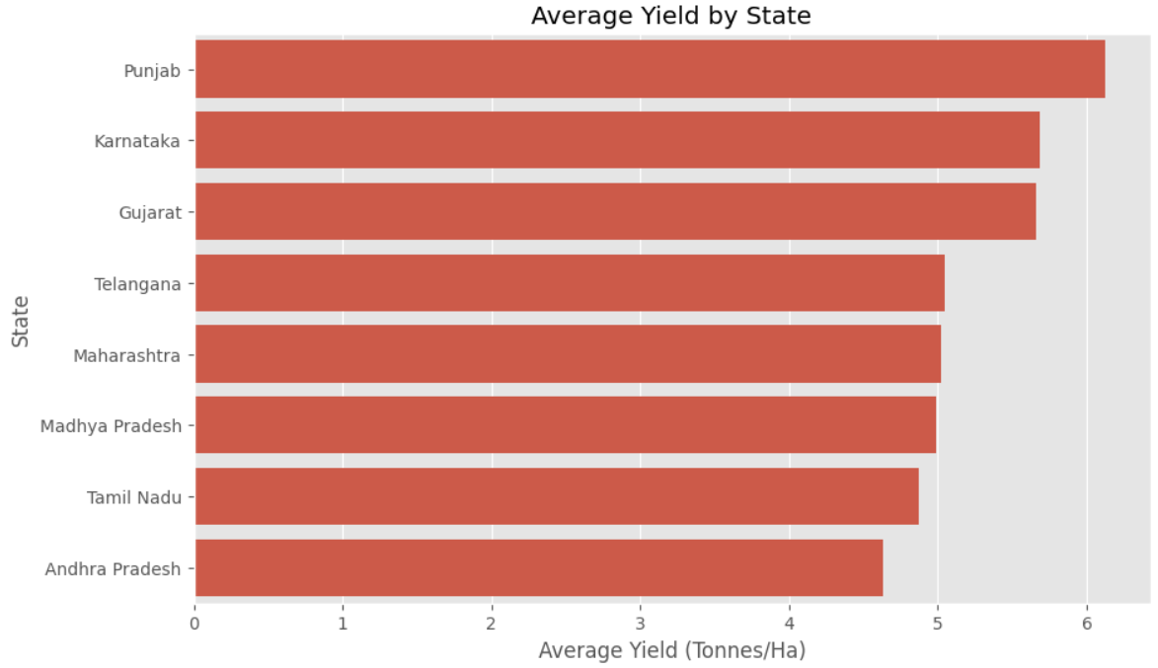
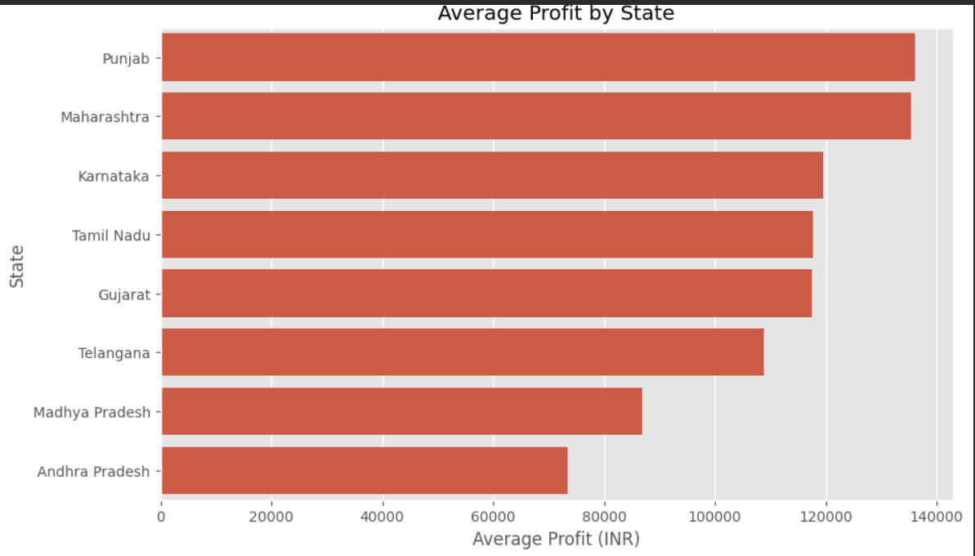
RESULTS
Insight-
Agricultural performance varied across states. Punjab achieved the highest average yield (6.12 tonnes per hectare) and also generated the highest average profit. Karnataka and Gujarat also showed strong performance, while Andhra Pradesh recorded comparatively lower profitability.

Slide 11
Conclusion Key Results
Seasonal variations significantly affect agricultural productivity and profitability.
Kharif emerged as the best-performing season in terms of yield and profit.
Water-related factors such as rainfall and soil moisture play an important role in agricultural outcomes.
Efficient irrigation methods can improve water utilization and support sustainable farming.
Regional differences exist, with Punjab demonstrating the strongest agricultural performance.
Data analytics helps identify meaningful agricultural patterns and supports informed decision-making.
Kharif season recorded the highest average yield and profit.
Average profit during Kharif was ₹178,914.65.
Zaid season showed negative average profit (-₹24,804.82).
Rainfed irrigation achieved the highest water efficiency.
Yield and Profit showed a moderate positive correlation (0.49).
Punjab recorded the highest average yield (6.12 tonnes/hectare).
Punjab also generated the highest average profit among all states.
Rainfall and soil moisture were important environmental factors influencing agricultural performance.

Slide 12
Future scope
• Include data from additional states and crops.
• Analyse long-term agricultural trends.
• Develop interactive dashboards for visualization.
• Integrate real-time weather information.
• Apply Machine Learning models for yield prediction.
• Build decision-support systems for farmers.

Slide 13
GitHub Link-
https://github.com/shreeyagupta2105-png/Seasonal-Agriculture-Performance-Analysis
Jupyter Notebook link - Here

Slide 14
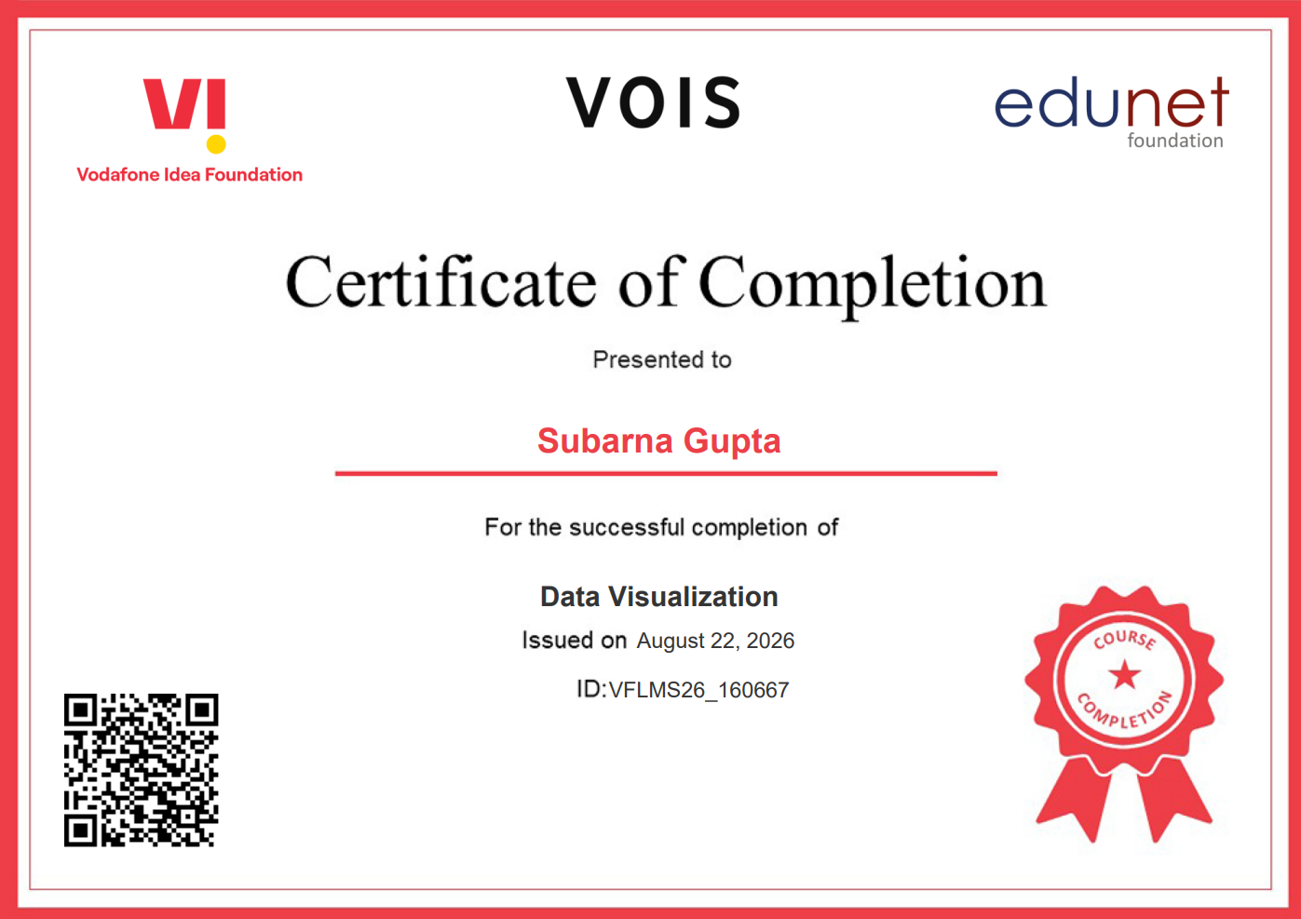
VOIS Course completion certificate - Course name- Data Visualization

Slide 15
Thank you
“Turning data into insights and insights into better decisions.”
.
.

